Slide 1

CIS-4951
With Dr. Bruce Maxim
Drone-Car Collaboration Project
Use Case Presentation
Demetrius Johnson
Ryan Sauer
Olivia Pellegrini
Jonathan Schall

Slide 2

Introduction
IoT (Internet of Things) devices have become very prominent in today's world of connectivity.
Vehicle to Vehicle (V2V) networks have been in development for many years now, and is essential to the development of autonomous vehicles
[refs: 1,2,3,4]
With the rollout of 5G standards and service, Edge Computing becomes a more powerful and feasible option for the doing computing on edge devices rather than relying on the cloud [refs: 1,2,3,4].
Edge computing can reduce latency and reduce network load (improve bandwidth).
So how can we put it all together?
autonomous vehicles + edge computing + V2V networks + battery power = optimization problem.
Notes:
Jonathan

Slide 3
Goals and Objectives
The main objective of our project is to develop a drone-car collaborative model that can be used to obtain data on drone-car collaboration. The model will use a drone camera to record the surroundings of the car and notify the car of potential hazards in real time. Some basic goals of our model are:
Accurately detect a potential hazard in multiple environments using sensors from the car and drone, particularly the vision systems (camera).
Minimize car stop-response-latency by optimizing the communication protocol between the drone and the car.
Maximize drone battery life.
Develop a working product that is open source and reproducible through our documentation to serve as a future reference/baseline for further research.
Notes:
Jonathan

Slide 4
Statement of Scope
An image recognition algorithm running on the drone for detecting a predefined object
A manual/automatic control mechanism for the car
A manual/automatic control mechanism for the drone
A multiple communication protocols for use between the drone and car
An ascii based log system to store data points about the drones battery life, bandwidth, and latency.
A way to extract drone data logs from the raspberry pi
A way to extract car data logs from the raspberry pi
Notes:
Jonathan

Slide 5
Software and Hardware Context
Raspberry Pi model 4B
https://www.raspberrypi.com/products/raspberry-pi-4-model-b/
Used as the onboard computing device for both the car and the drone (each has their own Raspberry Pi computing device) for autonomous driving/flying by taking input from the sensors and processing the information, and also for communications (networking) with between devices (vehicles), such as wireless communications, i.e. WIFI.
Raspberry Pi Ai Car Kit (PiCar-X) for Intermediate
https://www.sunfounder.com/products/picar-x
https://docs.sunfounder.com/projects/picar-x/en/latest/introduction.html
Used as the physical device for the car including motors, frame, driving mechanism, and sensors.
The Raspberry Pi OS imager should be used to image the sd card that will serve as the nonvolatile memory unit the Raspberry Pi computer of the car:
https://www.raspberrypi.org/software/
Here is the Repository that is cloned onto the Raspbian OS image of the Raspberry Pi; it will contain all of the installation files needed to program and control the car:
https://github.com/sunfounder/robot-hat
Clover Drone 4.2
https://clover.coex.tech/en/
Used as the physical device for the drone including motors, frame, propellers, sensors, Electronic Speed Controllers (ESC), GPS, etc.
Includes Pixracer R15 Mini Pixracer Autopilot Xracer FMU V4 V1.0 PX4 Flight Controller
https://docs.px4.io/main/en/flight_controller/pixracer.html
Notes:
meech

Slide 6
Software and Hardware Context
Python Programming Language
https://www.python.org/
We will use the Python programming language for both the car and the drone.
OpenCV-Python Library
https://pypi.org/project/opencv-python/
This is a Python vision analysis library that has been adapted from a library originally written for C++
We will use it to analyze vision data collected from cameras on both the car and the drone.
Raspbian OS builds with Linux Kernel
https://www.kernel.org/
Both the car and the drone have their own onboard computing device (Raspberry Pi model 4B) with a custom modified version of the Raspbian Operating System image that uses the Linux Kernel.
Additionally, the Clover 4.2 Drone uses the ROS robotic framework used for advanced robotic distributed systems.
https://wiki.ros.org/
Here is the image used for the Clover 4.2 Drone Raspberry Pi computer:
https://github.com/CopterExpress/clover/releases/tag/v0.23
Image features:
Raspbian Buster
ROS Noetic
Configured networking
OpenCV
Mavros
Periphery drivers for ROS (GPIO, LED strip, etc)
Aruco_pose package for marker-assisted navigation
Clover package for autonomous drone control
Notes:
meech

Slide 7
Software and Hardware Context
Q Ground Control
https://docs.qgroundcontrol.com/master/en/
This is an open source software used to communicate with and calibrate and configure a drone’s flight controller firmware. We will use this to calibrate the drone and manage the flight controller’s parameters and how the flight system of the drone uses and responds to sensor data.
Here is the firmware image used for our flight controller:
https://github.com/CopterExpress/Firmware/releases/tag/v1.8.2-clover.13
Clover Drone Simulation virtual machine (VM) image
https://github.com/CopterExpress/clover_vm
This is the virtual machine image used to run the simulation software used to simulate programmed autonomous flights for the Clover 4.2 Drone.
Image contains:
Ubuntu 20.04 Focal.
ROS Noetic.
PX4 autopilot, QGroundControl.
Preinstalled Clover and Clover simulation packages.
Shortcuts for running Clover simulator.
VSCode.
Useful robotics-related software.
Drone Simulation Environment (Using Gazebo software)
The simulation environment is based on the following components: Gazebo, a state-of-the-art robotics simulator;
http://gazebosim.org/
PX4, specifically its SITL (software-in-the-loop) components;
https://px4.io/
sitl_gazebo package containing Gazebo plugins for PX4;
https://github.com/PX4/sitl_gazebo
ROS packages and Gazebo plugins
Note: all of the above components are installed on the Clover Drone Simulation VM in order to do simulation programming without the Raspberry Pi on board computing device of the drone. This allows for programming and simulation without needing the physical drone present.
Etcher - Flashing Software
https://www.balena.io/etcher
This is the software used to flash the micro-SD card with the respective OS (drone or car) used as the nonvolatile memory unit for the Raspberry Pi computers.
Notes:
meech

Slide 8
Software and Hardware Context
What is ROS (Robot Operating System)?
http://wiki.ros.org/
ROS (Robot Operating System) provides libraries and tools to help software developers create robot applications. It provides hardware abstraction, device drivers, libraries, visualizers, message-passing, package management, and more. ROS is licensed under an open source, BSD license.
MAVROS (package)
http://wiki.ros.org/mavros
MAVROS -- MAVLink extendable communication node for ROS with proxy for Ground Control Station.
This package provides a communication driver for various autopilots with MAVLink communication protocol. Additional it provides UDP MAVLink bridge for ground control stations (e.g. QGroundControl).
MAVLINK (package)
http://wiki.ros.org/mavlink?distro=noetic
MAVLink message marshaling library. This package provides C-headers and C++11 library for both 1.0 and 2.0 versions of protocol. For pymavlink use separate install via rosdep (python-pymavlink).
This package provides a communication library for various autopilot systems. This package contains both C-headers and pymavlink.
mavros_msgs/Mavlink Message
http://docs.ros.org/en/api/mavros_msgs/html/msg/Mavlink.html
The above link is the header file to the mavrov_msgs class which is used as a message transport class to convert between ROS and MAVLink message types.
Used to transport mavlink_message_t via ROS topic
Here is the documentation for the mavros_msgs class: http://docs.ros.org/en/api/mavros_msgs/html/index-msg.html
mavros_msgs defines messages for MAVROS
And here is another important class sensor_msgs: http://wiki.ros.org/sensor_msgs?distro=noetic
At least this package uses its own bundled (or installed by pip) mavlink headers or pymavlink: mavlink_ros, rospilot, roscopter, autopilot_bridge, px4-ros-pkg.
ros_core
Here is the documentation for ros_core class: http://wiki.ros.org/ros_core?distro=noetic
A metapackage to aggregate the packages required to use publish / subscribe, services, launch files, and other core ROS concepts.
libmavcon
http://wiki.ros.org/libmavconn?distro=noetic
MAVLink communication library. This library provide unified connection handling classes and URL to connection object mapper. This library can be used in standalone programs.
catkin library
http://wiki.ros.org/catkin?distro=noetic
Low-level build system macros and infrastructure for ROS.
Notes:
meech

Slide 9
Major Constraints
The project needs to be completed by August 15th, 2023. This gives us approximately six months to complete the model. However, after the model is finished, we would like to use it to collect research data of our own. In order to do this the model would need to be finished before August.
Currently we are working with the PiCAR-x and the Clover Drone
We will be obtaining Raspberry-Pi’s in order to give everyone on the team the ability to work with one. Outside of this, there will be a very limited budget and it is unlikely the remaining budget can afford extra drones, cars, or expensive technology.
The Raspberry Pi for the PiCarX is coming in later than anticipated, preventing us from being able to work on it.
Additionally, drone flight regulations from University and state policies make finding and developing a more comprehensive test environment more challenging and limited.
Notes:
Ryan

Slide 10
User Profiles and Stories
Vehicle Administrator
Manages vehicle condition
Makes pre-approved adjustments to vehicles parameters
Experiment Facilitator
Carries out experiments
Ensures safe protocols are in place
Alerts vehicle administrator to parameter adjustments
Data Analyst
Controls data collection methods
Retrieves data from vehicles after experiment
Parses data and produces results
Notes:
Ryan

Slide 11
User Profiles and Stories
Make adjustment to car parameters
Vehicle Administrator
Make adjustment to drone parameters
Vehicle Administrator
Run test flight using drone and car
Experiment Facilitator
Recall logs from drone
Data Analyst
Recall logs from car
Data Analyst
Compare data from previous tests
Data Analyst
Change communication protocol between drone and car
Vehicle Administrator
Notes:
Ryan

Slide 12
Special Usage Situations
Tests must take place in a controlled environment
In house only data use removes the need for data masking
All parameter changes must be documented thoroughly for continuity
Drone policy on campus is strict and we must be aware of every rule and adhere to them throughout the process
Notes:
Ryan

Slide 13
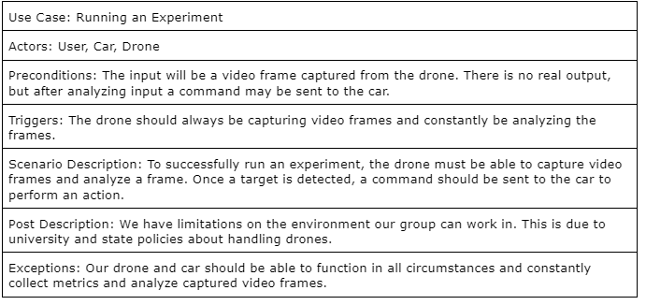
Description for Function n
Notes:
Jonathan

Slide 14
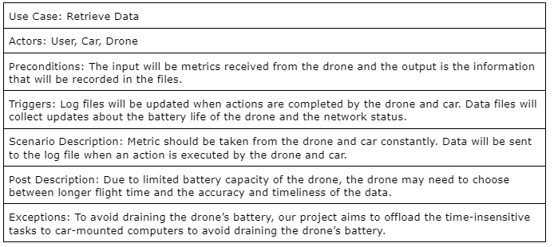
Description for Function n
Notes:
Jonathan

Slide 15
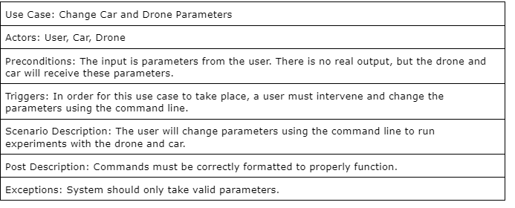
Description for Function n
Notes:
Jonathan

Slide 16
Software Interfaces
External Interfaces:
Clover Drone:
The clover drone will be accessed in order to run the required programs for flight, vision analysis, and networking. We will be using QGroundControl and SSH to communicate with the drone. QGroundControl will be covered in External System Interfaces. SSH is installed on the drone ahead of time and will allow us to place our programs onto the drone as well as recover data and log files.
PiCarX: The PiCarX can also be connected to via SSH for program changes and log file recovery.
System Interfaces
QGroundControl:
This is a program that allows us to connect to the Clover drone to monitor, control, calibrate, and configure the flight controller. It is a GUI based program for most systems which we will use to control the drone.
Dnsmasq:
Dnsmasq is a piece of software we will be utilizing on the PiCarX to act as a router for the connection point for the machines. It will be controlled through the command line.
Human Interfaces
Our software will have little to no human user interface. Any debugging interface will be done through command line input. All changing of values will occur in files
Notes:
meech

Slide 17
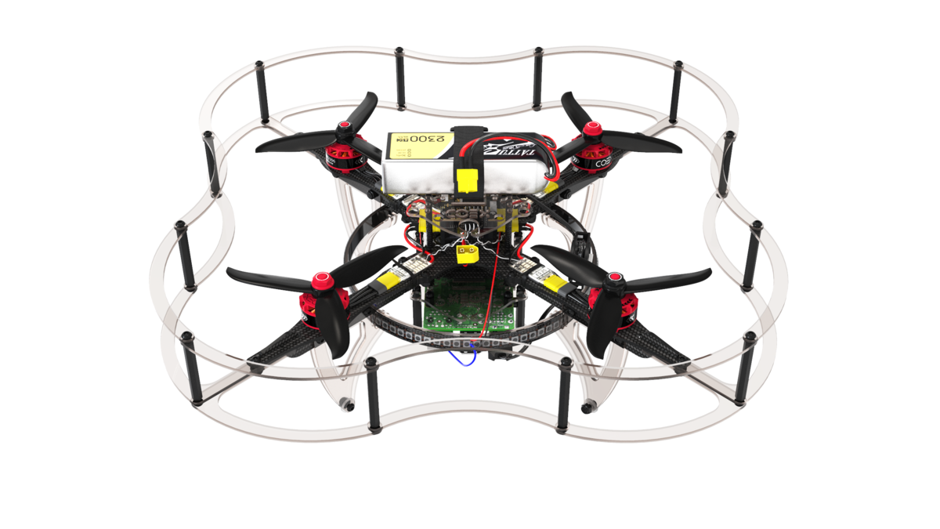


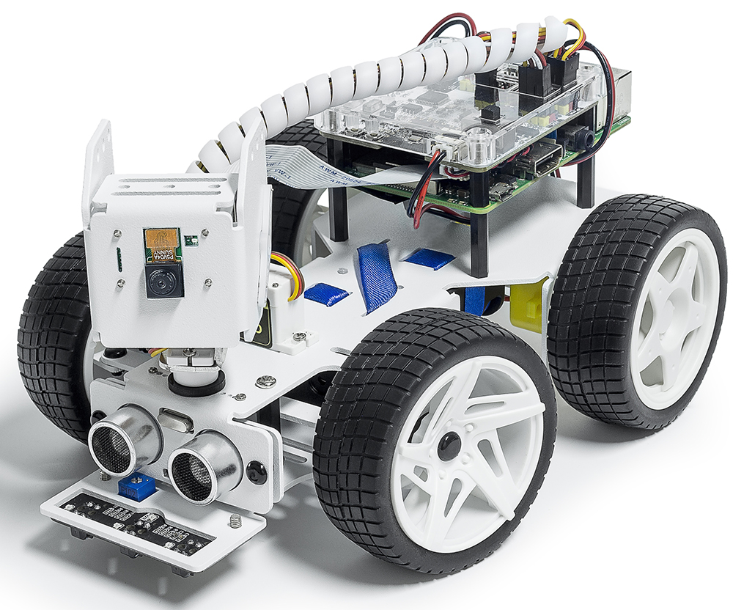

Use Case Diagrams
Actors in our Diagrams:
Clover Drone 4.2
PiCAR-X Car
Our Group Members
Notes:
Olivia

Slide 18
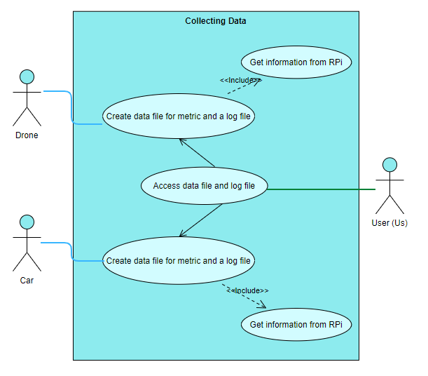
Collecting Data
Data file will include the battery life and network status.
Log file will hold information about the actions completed by the drone and car.
Information is collect from the RPi
Will be measuring latency (time to transfer data) and bandwidth (amount of data transferred) with data that is collected
User accesses the files to observe data
Notes:
Olivia

Slide 19
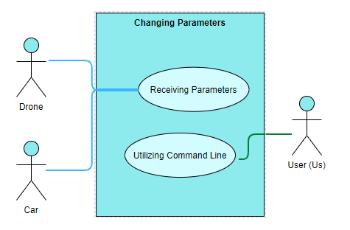
Changing Parameters
User will be able to change parameters using the command line
Allows user to pass input into our program and run an experiment
Drone and car both receive parameters in order to execute experiment
Notes:
Olivia

Slide 20
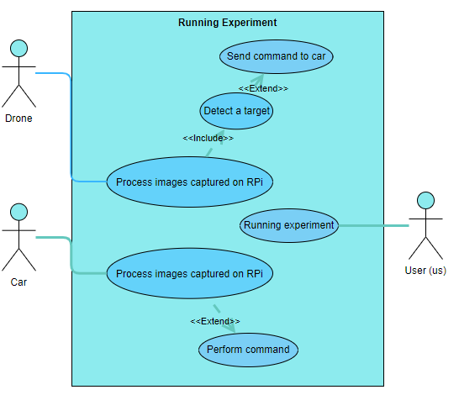
Running Experiments
Drone will capture video frames to be analyzed using OpenCV software
As our first task, we will be using it to detect color in a frame
Should detect a given target
Ex: a red car
Once detected, a command will be sent to the car
Ex: stop if a red car is detected
The command is then executed by the car (PiCARX)
Notes:
Olivia

Slide 21
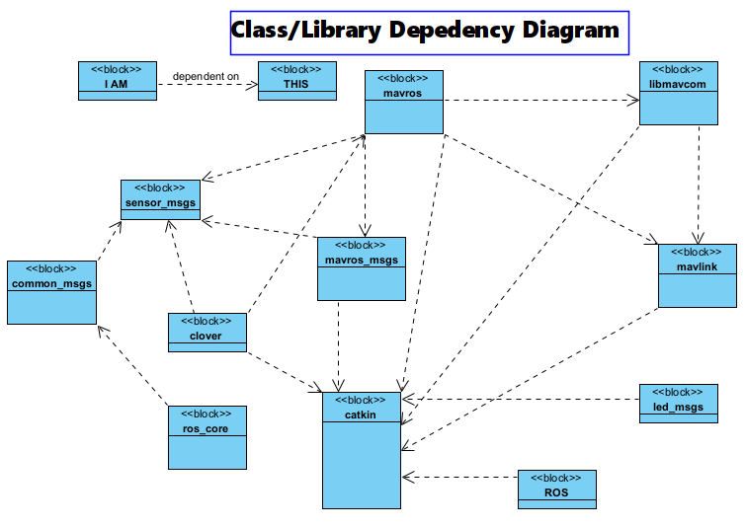
UML
Notes:
meech- we are still trying to determine exactly where our _Comm and _Collect classes will go in this software workflow, and exactly what it will depend on, but the above work narrows it down; we are closer with the drone as the above pertains to the drone, which is the main source of data we are concerned with at least for this first phase; but by final phase we want the drone and car to use _Comm and _Collect classes to collect and stream data to a log file or to each other for analysis. For the demo by end of Senior design 1, we need to at least know where the _Comm class should go so the drone and car can communicate; we still need to do some research on the car we have for this project.

Slide 22
Data Dictionary/Description
Class | Description | General Overview of Responsibilities | Collaborators/Relationships
_Comm | Use this class to create communication objects that can connect across devices (i.e. drone and car) through socket programming | Interface with mavros_node object on the drone, and car_communication_object on the car to establish a connection | Interface with mavros_node objects and _Collect objects, car_node_objects
_Collect | Use this class to collect data streams from sensors and store them in a log file locally, or redirect the stream to a network socket. | Provide an interface to collect data using drone and car data structures/objects, and writing the data to a log file or other stream. | Interface with _Comm objects and mavros_msgs objects
Mavros (mavros_node) | Main communication protocol (mavlink protocol) used on the drone | Provides communications with the drone. | Interfaces with mavros_msgs and mavlink objects
Notes:
meech

Slide 23
Data Dictionary/Description
Class | Description | General Overview of Responsibilities | Collaborators/Relationships
mavros_msgs | mavros_msgs defines messages for MAVROS | Provide data streams for subscribers to sensor and other information topics of the drone. | Interfaces with mavros_node and mavlink objects
sensor_msgs | Use this class to obtain data streams for laser range finder, camera, battery, etc, that we will send to a log file | Provide data streams for subscribers to sensor and other information topics of the drone (like laser range finder, camera, etc.) | Interfaces with mavros_node, mavlink, and _Collect objects
param_id[string] | Used to set a parameter to a value | Use this parameter to select and change a parameter in the mavros_msgs object | mavros_msgs/ParamSet.srv
Notes:
meech

Slide 24
Data Dictionary/Description
Class | Description | General Overview of Responsibilities | Collaborators/Relationships
libmavconn | May be the interface by which we can drop our _Comm class to establish drone-car communications. | MAVLink communication library. This library provide unified connection handling classes and URL to connection object mapper. This library can be used in standalone programs. | Depends on mavlink library, and catkin library
mavlink | May need to use this to establish communication between the car and the drone; libmavconn library may be the better interface to implement our communications, however. | MAVLink message marshaling library. This package provides C-headers and C++11 library for both 1.0 and 2.0 versions of protocol. For pymavlink use separate install via rosdep (python-pymavlink). | Depends on catkin library
catkin | Catkin is included by default when ROS is installed. Catkin can also be installed from source or prebuilt packages. Most users will want to use the prebuilt packages, but installing it from source is also quite simple. | Low-level build system macros and infrastructure for ROS.
Notes:
meech

Slide 25
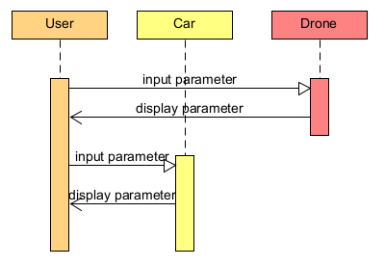
Sequence diagram - Changing Parameters
Notes:
Jonathan

Slide 26
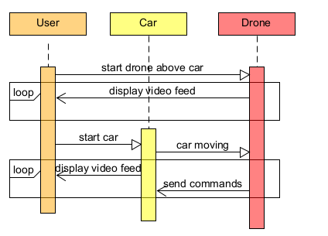
Sequence diagram - Running Experiment
Notes:
Jonathan

Slide 27
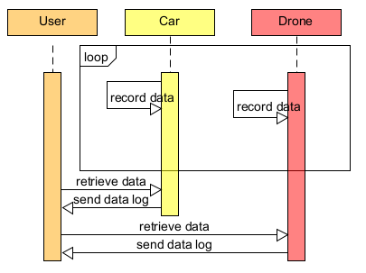
Sequence diagram - Collecting Data
Notes:
Jonathan

Slide 28
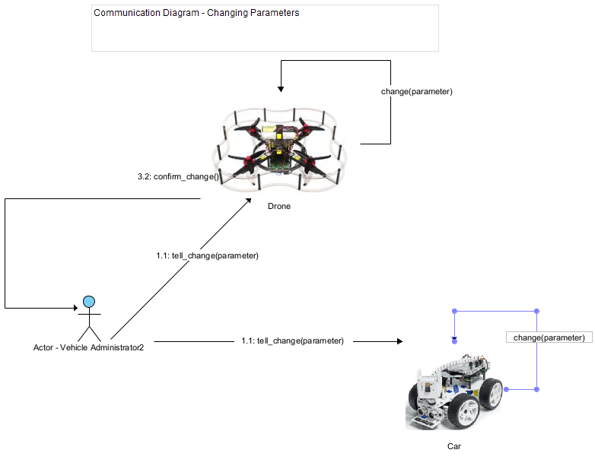
Communication Diagram - Changing Parameters
Notes:
Ryan

Slide 29
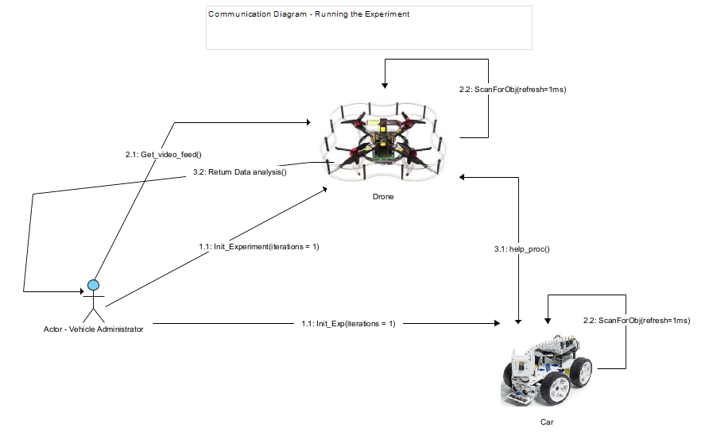
Communication Diagram - Running Experiment
Notes:
Ryan

Slide 30
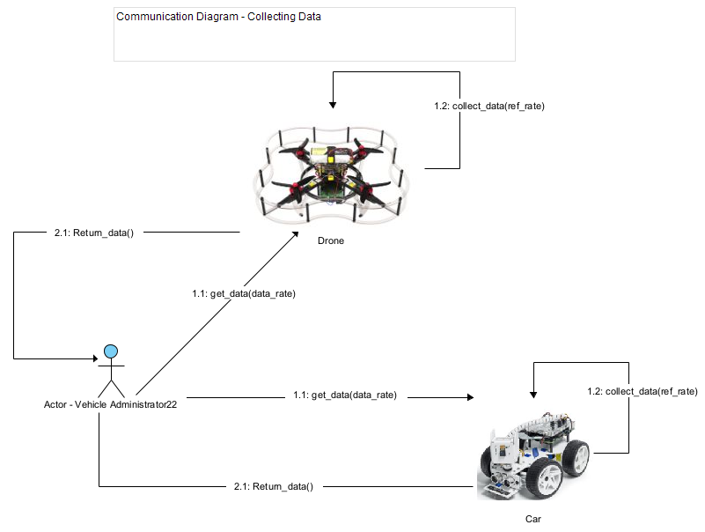
Communication Diagram - Collecting Data
Notes:
Ryan

Slide 31
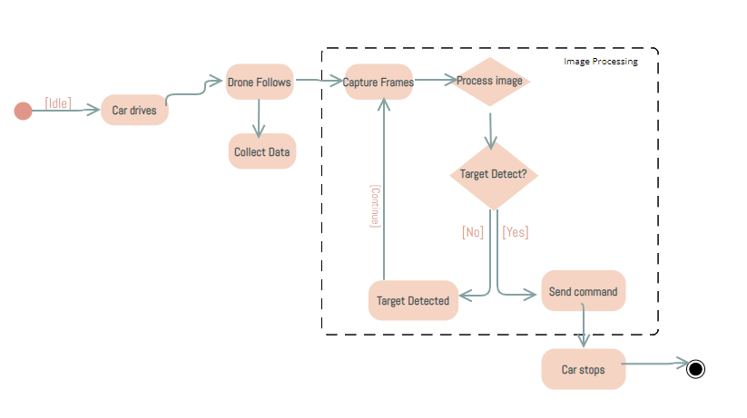
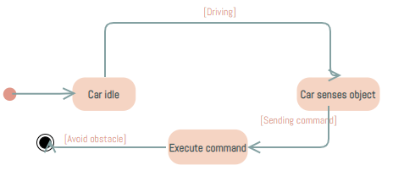
Description for Software Behavior with corresponding State Diagrams
External:
(1) The drone detects a red object.
(2) The car’s sensor senses objects around it like walls or other things in its way.
(1)
(2)
Notes:
Olivia (pt2 of SRS)

Slide 32
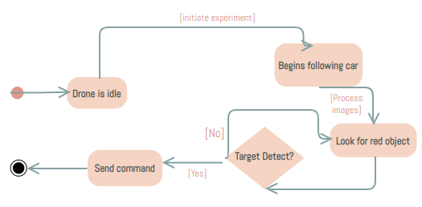
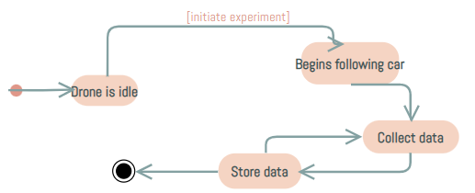
Description for Software Behavior with corresponding State Diagrams
Internal:
(1) Images received from drones are processed.
(2) Collect data from a drone to create data files.
(1)
(2)
Notes:
Olivia (pt2 of SRS)

Slide 33
Restrictions
Time:
We only have two semesters to get the software, hardware, and tests done from scratch with little to no experience with the subject matter beforehand. We have a lot of possible additions to the scope, but we may be limited by time. One of these additions is the addition of autonomous flight by the drone.
Expertise:
We are working with a lot of hardware and new interfaces/libraries we aren’t familiar with. We will have to use up time to learn how to use and work with these interfaces.
Access:
We have limited hardware (computing and vehicles) as well as limited access to them. We can work hands on with the drone and car when on campus and when we are given access to the testing facility, so we must be intentional about when we can be on campus and work with the hardware together.
Notes:
meech

Slide 34
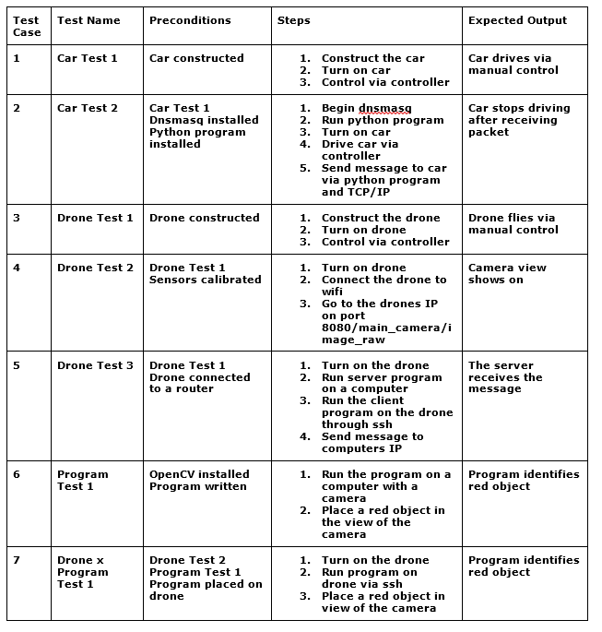
Validation
Notes:
meech

Slide 35
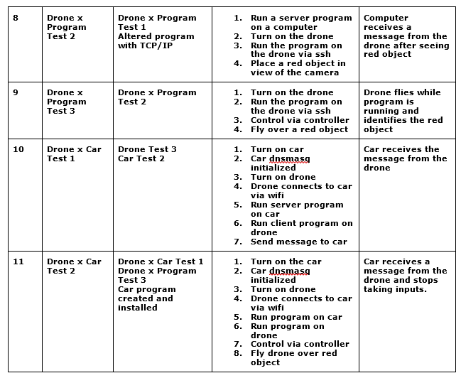
Validation
Notes:
meech

Slide 36
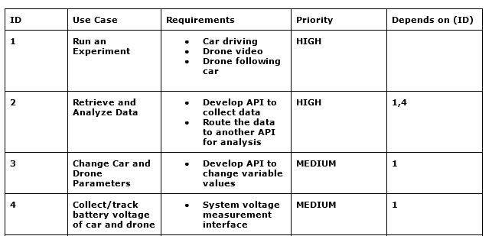
Traceability Matrix
Notes:
Ryan

Slide 37
Contact Us
Demetrius Johnson
meech@umich.edu
Ryan Saur
sauerr@umich.edu
Jonathan Schall
jcschal@umich.edu
Olivia Pellegrini
opelle@umich.edu
Dr. Zheng Song (Client)
zhesong@umich.edu
Dr. Bruce Maxim
Senior Design Professor/Director CIS-4951 Winter 2023
bmaxim@umich.edu

Slide 38
Project Schedule (backlog + gantt chart)
https://docs.google.com/spreadsheets/d/19jwEwpa6-wcxdM9MpsWajnalgw1fmSHmAJUBHp3Weyg/edit?usp=sharing
https://docs.google.com/spreadsheets/d/1Np0KL0MUnTC7GoU5v01r7UdblBakfGlUsDKDI06vU_Y/edit?usp=share_link
Notes:
meech

Slide 39
Research References
S. A. Hadiwardoyo, E. Hernández-Orallo, C. T. Calafate, J. -C. Cano and P. Manzoni, "Evaluating UAV-to-Car Communications Performance: Testbed Experiments," 2018 IEEE 32nd International Conference on Advanced Information Networking and Applications (AINA), Krakow, Poland, 2018, pp. 86-92, doi: 10.1109/AINA.2018.00025.
URL: https://ieeexplore.ieee.org/stamp/stamp.jsp?tp=&arnumber=8432227&isnumber=8432202
J. Yoon, I. Kim, W. Chung and D. Kim, "Fast and accurate car detection in drone-view," 2016 IEEE International Conference on Consumer Electronics-Asia (ICCE-Asia), Seoul, Korea (South), 2016, pp. 1-3, doi: 10.1109/ICCE-Asia.2016.7804775.
URL: https://ieeexplore.ieee.org/stamp/stamp.jsp?tp=&arnumber=7804775&isnumber=7804716
Yildiz, Melih, Burcu Bilgiç, Utku Kale, and Dániel Rohács. 2021. "Experimental Investigation of Communication Performance of Drones Used for Autonomous Car Track Tests" Sustainability 13, no. 10: 5602.
URL:
https://doi.org/10.3390/su13105602
Barbeau, Michel, Joaquin Garcia-Alfaro, and Evangelos Kranakis. 2022. "Research Trends in Collaborative Drones" Sensors 22, no. 9: 3321.
URL:
https://doi.org/10.3390/s22093321
Textbook: Software Engineering A PRACTITIONER'S APPROACH EIGHTH EDITION, by Roger S. Pressman, Ph.D. and Bruce R. Maxim, Ph.D.
Notes:
meech

